Slide 1
Peer Services in a Post-Pandemic World Tackling New Challenges in 2024
Riverside University Health System
Behavioral Health
Peer Support Services
SHARE Peer Workforce Conference

Slide 2
Introduction
Notes:
Hello, thank you for joining us today. My name is………….., (Title, Programs Supported, etc.)
Share lived experience in BH and what brought you to this moment with this audience.

Slide 3
Agenda
Pre-Pandemic Peer Support
Having a Peer Support Infrastructure = Hope
Pandemic Era Recognition of Resiliency
Explore the Human Condition
Organizational Change in High Gear
Embracing What Is to Come
Notes:
Today we will be discussing

Slide 4
What Was Going Well for Your Peer Support Program Before the Pandemic Hit?
Notes:
(Ask the question)
(Discuss responses)

Slide 5
Peer Support Infrastructure
Hope
Communication
Training
Mentorship
Laws
Practice Guidelines
Peer Career Trajectory
Organizational Leadership – Buy-in & Support
Notes:
(Click through slide and talk about each subject)
In 2020 – for Riverside County – With the launching of CalAIM, public BH was in the throws of statewide change.
Before the pandemic hit, our organization had some goals around how we support our peer program as the CalAIM changes were occurring.
Org Leadership – Buy-in: When most of us were building a peer support program, it is very important that the system’s organizational leadership was focused on making sure the environment in the organization was supportive and positive about bringing people with lived experience into service provision. History tells us that without that support, peer support programs can be disjointed and lack credibility as a sustainable and effective treatment option for the people we serve. This is foundational and we were really working hard to get messaging from the top of the organization that we are supported. However, some systems had not done this.
Peer Career Trajectory: Promoting Peer Career Ladders provided hope for advancement and promote growth in recovery and professional skills. However, some systems had not done this.
Laws: The State of California passed a law (SB803) that has legitimized and defined the peer support role and responsibilities.
Practice Guidelines were established – our PRACTICE is evidence-based – We know that research paper after research paper has proven that peer support improves outcomes.
Training: Training has been standardized by the State, and the training is not just for peers, but for supervisors and systems to recognize the value of lived experience on treatment teams.
Mentorship: As with other disciplines, peer support mentorship is an important part of peer skill development and better outcomes at the clinic level for the people we serve.
Communication: When the peer program planning, development and implementation processes are communicated with the many systems within the organization, the resource of the peer provider is more easily recognized and utilized on the ground. Better outcomes through Peer Support Specialist engagement is based in evidence.

Slide 6
When Everything Stopped
Notes:
(Trigger Alert)
I am going to ask you to go back in your minds to when everything stopped.
In-person work as we know stopped.
We had to pivot and improvise.
We had to learn new things.
We were feeling the pressure.

Slide 7
Where Were You?
In Your Work Life
In Your Personal Life
In the Things You Were Working On
The State of Your Recovery
The State of Your Loved One’s Recovery
In Your Community Activities
In Your Day-to-Day Life
In Your Relationships
Notes:
Where were you in you work life?
Where were you in your personal life? How was your loved one’s recovery going?
What were the things you were working on?
What state was your recovery in? Were you doing well? Was it rocky?
(Validate responses)
(Remind of grounding in Hope Remembrance and Resilience)
I know where I was. I was the Administrator for our peer program
I was asked to be on the CalAIM Steering Committee.
I had taken a trans youth in as a foster
I was working on the Peer Certification Curriculum
I was well
My mother was in declining health, my childrens were both working
I was neglecting my social life, because I was overworked and leaning on old workaholic behavior, my husband was as supportive
I was dealing with toxic biological family members and reaching the “I’m done” place with them

Slide 8
Minute By Minute Change
Notes:
We were receiving messages
New media announcements about locking down.
Policy changes at each facility.
Direction given by health and safety professionals.
Wear a mask.
Don’t wear a mask.
Transmission is touch.
Transmission is airborne.
Most are working remotely.
Most have never used a virtual platform.
People are coming back to the office that doesn’t operate in any way as your muscle memory serves.
What happens to us when change happens continuously?
(Validate responses)
(Discuss Stress)

Slide 9
What Was Changing?
Notes:
(Ask the question) What was changing for you?
(Discuss responses)
Maybe your kid needed to be homeschooled.
My daughter and her girlfriend lost their apartment, so they had to move in with me.
My trust in media news outlets.
Access to my support system in-person.

Slide 10
Supporting People Through Change
Be the evidence
Role model
Facilitate Groups
Support individuals to learn new ways to wellness
Provide training and role-modeling to all staff in “hopeful” interactions
Create and model a recovery environment
Allow the person they are serving to take the lead
Notes:
These are the things we do in our peer roles to support people through change.
Be the evidence that recovery is possible (expand)
Be a positive role model (give examples) SUITING UP AND SHOWING UP
Share their lived experience in a meaningful way (share a piece of your journey with the participants to model it)
Lead by example – practice and communicate appropriate boundaries
Walk side-by-side with the person they are serving – do WITH, not FOR
Model recovery language at all times – not to correct a person, but to model it
Exemplify empowerment and encouragement
Resist the urge to “fix”
We walk the walk and talk the talk. We understand the recovery journey.
We have a practice like any other discipline.
We are bound by the Medi-Cal Code of Ethics that we learn in our Medi-Cal Peer Support Certification Course.
Ask for any questions or clarification?

Slide 11
Our Role Is Never Supposed to Change
Notes:
Our Lived experiences of recovery and wellness has taught us so much.
We know that our roles never change with the people we serve.
And we took a role a Peer Support Specialist to be there for the people serve. That role is never supposed to change.
Be we were being required to do things we maybe have never been trained to do.
Having to metabolize minute by minute change and to move and behave in different ways from one day to the next?
That is stressful.

Slide 12
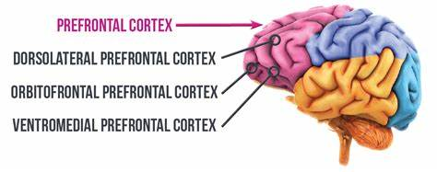
What Happens to Humans Under Pressure?
Brain Change
Notes:
Sian Bielock – Harvard University
Our prefrontal cortex, found in the part of your brain situated right above your eyes, is the epicenter of our cognitive horsepower, powering our ability to focus on the task at hand. When we are performing our normal, practiced tasks everyday, we often are – counterintuitively — not paying attention to all the little details of what we are doing; our prefrontal cortex is running largely on autopilot. But in times of intense stress, like a playoff game, major presentation, a job interview, or the constant change and uncertainty of pandemic-era work environments, your prefrontal cortex can go into overdrive. When the pressure is on, we often start focusing on the step-by-step details of our performance to try and ensure an optimal outcome and, as a result, we disrupt what would have otherwise been fluid and natural.
When the pressure is on, we tend to panic — about the situation, its consequences, and what others will think of us — and as a result we apply too much cognitive horsepower to what we are doing. We start overthinking something that usually comes naturally to us.
(Personal WRAP)
(CHAT)
How did this manifest in you?

Slide 13
Some People Thrive Under Pressure
They embrace challenges.
They have a positive attitude.
They are resilient.
They are proactive.
They are disciplined.
They are great problem-solvers.
They are adaptable.
They are focused.
Notes:
Does some of this look familiar? Or is this the antithesis of you? OK
People in recovery are built to thrive under pressure.

Slide 14
Some People Do Not Thrive Under Pressure
WHY?
The Recovery Journey Has Taught Us to:
Practice Self-Care
Be Trauma-Informed
Honor Voice and Choice
Because TRAUMA
Fear of the Unknown
Pre-existing Challenges
Nervous System Overload
Specific Traumatic Experiences
Fight or Flight Response
Notes:
Why wouldn’t a person NOT thrive under pressure? (CHAT)
(validate responses)
Our recovery journey has taught us that self-care comes first.
Our recovery journey has shown us that we must be trauma-informed in all things.
Our recovery journey has taught us that our voice and choices are worthy of being honored and respected
Thriving under pressure is actually counter all that we have been conditioned to do, because our sense of “caring for self” and understanding our trauma.

Slide 15
What Happened to Us?
Notes:
(Ask the Question)
When we were on the other side of the height of the pandemic, what have we, as humans, discovered about ourselves and the community? (CHAT)
We recognize our resiliency.
That we can do hard things.
The strength of the human condition was stretched beyond limits we thought we had.

Slide 16
The Human Condition
Loss of Family
Loss of Friends
Loss of Income
Loss of Business
Untreated Illness – Chronic Conditions – Deferred Screening and Assessment
Our Children’s Connections in School
High School Rights of Passage (Cheerleading, Football Team, Prom, Graduation, etc.)
Isolation
Systems Moving Forward Out of Sight
Notes:
Let’s talk about the human condition.
We lost a lot.
This is just the tip of the iceberg.

Slide 17
The State Moves on CalAIM
Notes:
Although the world seemed to stop, our systems soldiered on with State-mandated timelines that felt unsurmountable.

Slide 18
DHCS Requirements for Peer Services Under CalAIM
Take advantage of Medi-Cal billing opportunities
Implement an organized delivery of SUD treatment across a continuum of care
Provide folks with Medi-Cal Peer Support Services and a range of evidence-based SUD treatment services
Peer Support in SUD cannot bill, unless Medi-Cal Certified
Prioritize Medi-Cal Peer Support Certification, if the agency has opted-in
Notes:
Requirements state:
“Take advantage of Medi-Cal billing opportunities not previously, or formally recognized.”
“Implement an organized delivery of SUD treatment services across a continuum of care to Medi-Cal eligible individuals with substance use disorders”
“DMC-ODS programs provide Medi-Cal beneficiaries with a range of evidence-based SUD treatment services, in addition to those under the DMC program”
“DMC-ODS guidelines require that Peer Support Specialist cannot bill Medi-Cal for SUD treatment, unless they are Medi-Cal Certified”
If your agency has opted-in, making State Certification for the peers is a wise priority.

Slide 19
Organizational Change in High Gear
Notes:
Organizations all over the state – across the world – had to change so much of what they were doing and how they were doing it.
When organizations opt-in to funded programs, there is a sense of urgency by that organization to take full advantage of that opportunity.
Most organizations don’t really think about how change affects humans, like peers do, because we are keenly aware that change is difficult.
Systems – in general – lack the compassion of recovery-oriented approaches – they just move, place expectations on the folks doing the work and expect results.
Show of hands – how many of your agencies began new Trauma Informed Systems activities after everybody came back to the office?

Slide 20
Medi-Cal Peer Support Billing?
Brain Change
Notes:
Here’s that Brain Change Again.
There is a lot that goes into setting up systems to bill Medi-Cal for those that had not done it in the past. It’s a huge undertaking.
That’s pressure – on everyone involved.
The finance people
The electronic record people
The Peers to understand what those activities are that are billable, and what codes and other administrative tasks are involved
Management’s understanding of what DHCS has defined in the Medi-Cal Peer Support Specialist role.

Slide 21
Establish a Duty Statement of Responsibilities
Clear
Specific
Program-centric
State & Federal Law
Framed in Practice Language
Notes:
For CPSS in RUHS-BH clinics and programs, it was important to establish clear duty statements that share (with peer staff, supervisors, administrator) the job expectations.
The Duty Statement should: (Bullets)
Be specific and tie to the Peer Support values and ethics. Think about the tasks that tie to the three Medi-Cal sited areas of direct services
Therapeutic Activity
A structured non-clinical activity provided by a certified Peer Support Specialist to promote recovery, wellness, self-advocacy, relationship enhancement, development of natural supports, self-awareness and values, and the maintenance of community living skills to support the person’s treatment to attain and maintain recovery within their communities. These activities may include but are not limited to, advocacy on behalf of the beneficiary; promotion of self-advocacy; resource navigation; and collaboration with the beneficiary and others providing care or support to the beneficiary, family members, or significant support persons. Services may also include consultation and/or training of the significant support person(s) in the life of the individual served (with or without that individual). The purpose of consultation or training of the support person is to assist in increasing the consumer’s resiliency, recovery, or improving utilization of services; assisting the support person to better understanding of substance abuse and/or mental health conditions and the impact on the person engaged in services to improve day-to-day life and living of the person being served.
Engagement
Activities and coaching led by Peer Support Specialists to encourage and support consumers to participate in behavioral health and substance use treatment. Engagement may include supporting consumers in their transitions between levels of care and supporting consumers in developing their own recovery goals and processes.
Education Groups
Providing a supportive environment in which consumers and their families learn coping mechanisms and problem-solving skills in order to help the consumer achieve desired outcomes. These groups promote skill building for the consumers in the areas of socialization, recovery, self-sufficiency, self-advocacy, development of natural supports, and maintenance of skills learned in other support services.
Address program-centric expectations (forensics and mandated treatment looks different than outpatient services)
Reflect of State and Federal Law requirements (Medi-Cal Code of Ethics, Tarasoff and HIPAA)
Expectations formed in recovery-oriented language

Slide 22
Mentorship
Assign an appropriate mentor
Define the mentor’s role
Non-punitive role of mentor
Ongoing training & support
Notes:
We felt it fundamental that we assign an appropriate mentor.
This means having that peer provider learn, in real time, role-modeled practice (Leadership-Level Peer. Parent Partner, Family Advocate).
Create a Duty Statement for the mentor (SPSS have a separate set of duties)
Mentors should never have a punitive role with whom they are partnered.
(Describe Senior Peer Role in RUHS-BH)
Ongoing training & support for peer practice, as well as programmatic processes and procedures.

Slide 23
Opportunities in the Clinic
To recognize the peer as a resource
To create a timely service environment
To bring more recovery into the environment
To allow for connection folks are seeking
To be welcoming, inclusive and diverse
Notes:
When peers engage with the people we serve, there is an instant connection, due to the mutuality that is established in the first moments of that engagement.
Peers can be the first touch in many environments and can provide support while screening a new participant in services.
Their practice requires that they create a recovery-oriented and hopeful environment at all times – it’s in their Code of Ethics. They recognize micro-aggressions, non-recovery interactions, emotional and physical barriers of the people and the spaces where they are employed. It is their role to bring them up in supervision, to address, advocate for change and problem-solve.
A peer recognizes when a space lacks hope. There are places we have all worked that could use a “hope barometer”.

Slide 24
Hope Barometer
Notes:
A peer recognizes when a space lacks hope. They have been in a hopeless place, and they can help us to find it in ourselves and the environments where we serve.
There are places we have all worked that could use a “hope barometer”.
(Ask: “What do you think I mean when I say that ‘Hope Barometric Pressure’ is low in here?”)

Slide 25
The Recognition of Our Peerness
Notes:
I’ll bet most of us, recently, have encountered a person, who would normally not identify as peer.
Show of hands – how many of you, during the height of the pandemic or shortly thereafter, talked with someone who expressed for the first time their struggles with anxiety, depression, having to start a wellness routine or meds – someone you would never think would “come out”?
People all over the world have come to terms with their peerness. Whether it was through social media or community group done on Zoom
What they are recognizing is compassion

Slide 26
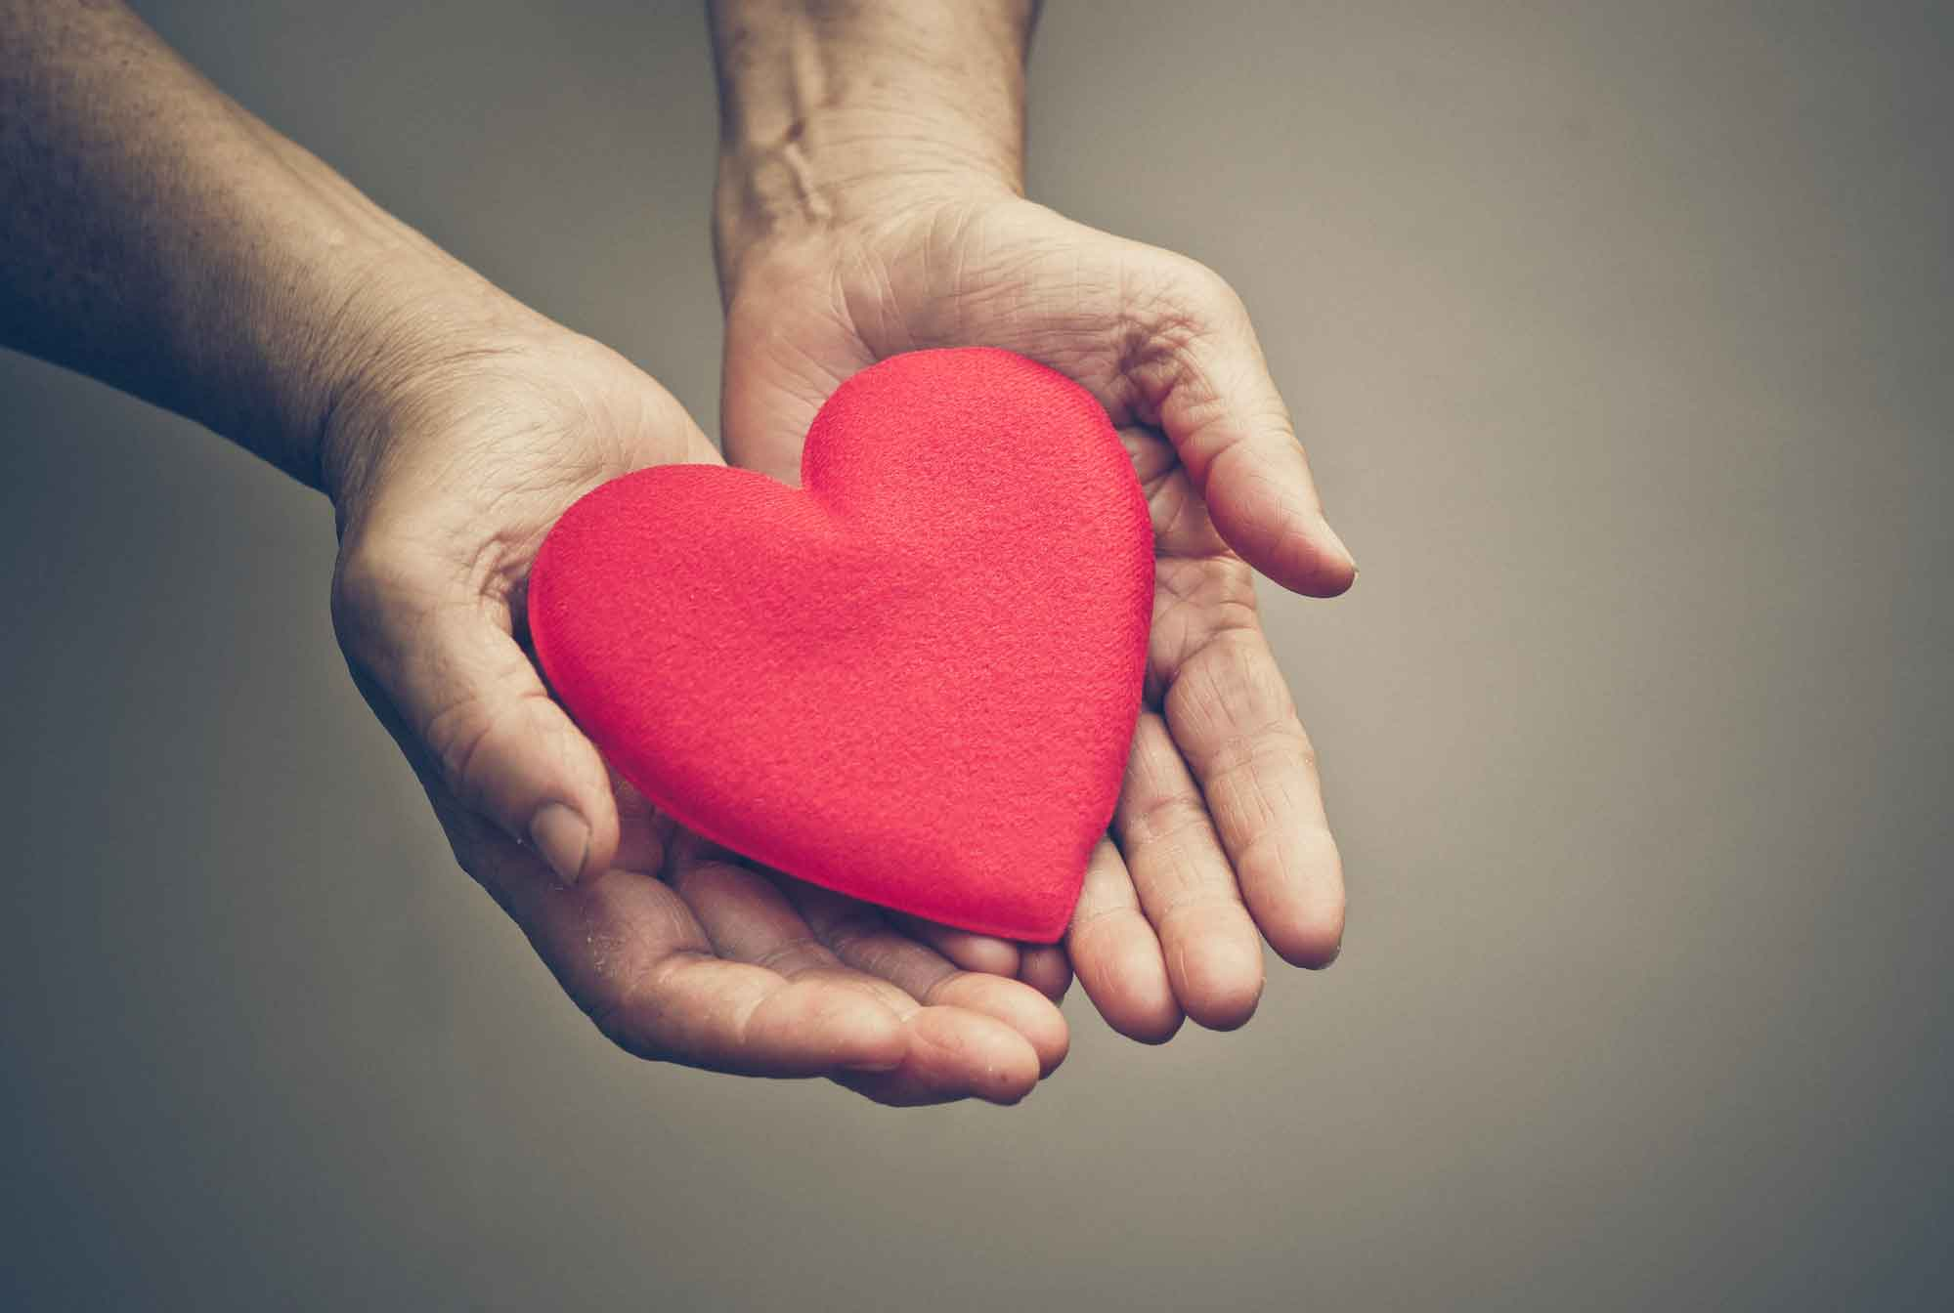
Notes:
Someone showed them that their vulnerability was a stretch and we supported them.
We recognize that mutual connection and kindness in the worst circumstances affects change.

Slide 27
The Forward Motion Can Be Good
Notes:
Clinic supervisors are participating in more recovery-oriented trainings, and have come to realize that recovery is universal, because they, too are recovering from the trauma of the pandemic.
This is your moment.
This is your opportunity to shine.
To influence hopeful community service environments.
To create recovery-focused and hopeful workplaces.
To share our Medi-Cal Code of Ethics. 9FRAME IT!)
When staff are understanding the peer support values and ethics, they become more oriented to hope.
Supervision, whether one-on-one or in groups, become opportunities for the team to build upon the recovery concepts that are ever-present in the peer role.

Slide 28
Collaboration Through CalAIM
Better Outcomes
Community-Based Providers
Physical Health
Hospitals
Mental Health
Substance Use Treatment
Public Behavioral Health
DHCS Oversight
Notes:
Thru CalAIM, DHCS is encouraging – requiring - agencies to collaborate across systems. This includes Peer Support Services provision.
Creating a Peer Support infrastructure facilitates effective implementation of Medi-Cal Peer Support Services system wide.
Soon we will find Peer Support staff in all areas of public health and welfare, which means our work in building infrastructure for peer programs is so important now.

Slide 29
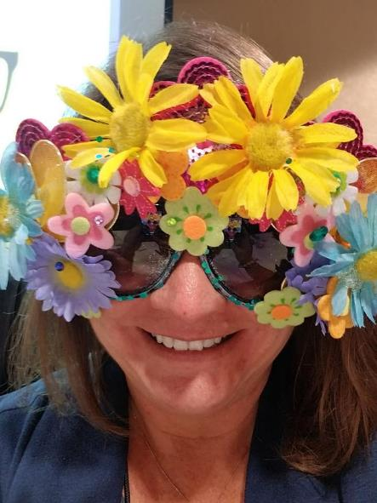
Questions?

Slide 30
If You Need Support
CONTACT:
Shannon McCleerey-Hooper
Deputy Director of Peer Support Services
951-955-7117
SMcCleereyH@ruhealth.org

